Slide 1
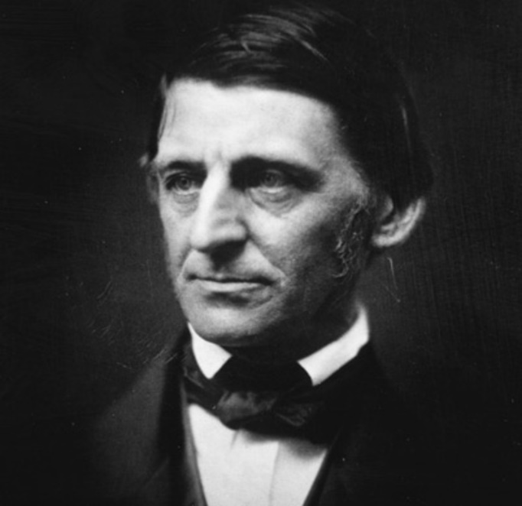
Self Reliance
By Ralph Waldo Emerson

Slide 2
Introduction:
Written By American Transcendentalist philosopher and essayist Ralph Waldo Emerson.
It emphasizes the importance of individualism and its effect on a individual’s satisfaction in life.
Emerson argues that polite society has an adverse effect on personal growth.
It gives freedom to discover one’s true self and attain through independence.

Slide 3
Emerson Conveys:
Emerson urges the reader to follow his personal will.
He emphasizes following one’s own voice rather than intermediary.
He encourages the readers to be honest in their relationship with others.
Emerson posits the effects of self reliance.

Slide 4
Main Idea:
He propagates self-trust and the independence of the individual.
He advocates his reader to follow their own will rather than to sticking to people’s path.
Both hope and optimism are essences of self reliance.
Admonishes his readers to avoid depth as that will crop them of opportunities.
Self reliance is the foundation of productive efficient and self-sustaining society.
Conformity is death to an individual.

Slide 5
Themes:
Non-Conformist (should believe in other ideas too)
Trusting One’s Inner-prompting (inner voice)
Anti-Assimilationism (listening to one’s own voice rather merging)
Intuition (to pay heed to what inner self tells you to do)
Originality (to believe and do things what we think are genuine, real)
Believe in Yourself (faith and self-trust/confidence)
Transcendentalism.
Confidence.
Love Thyself.

Slide 6
Psychology of Self Reliance
“ Ne te quaesiveris extra. ”
(Do not seek for (answers, solutions and opinions) outside of yourself.)
History cannot be an enlightenment only individuals should search for themselves
Truth lies inside a person and this is an authority not an institution or religion
Community is a distraction for self-growth.

Slide 7
Famous Quotations:
A foolish consistency is the hobgoblin of little minds, adored by little statesmen, philosophers and divines.
Nothing can bring you peace but yourself.
Envy is ignorance, imitation is suicide.
Spirituality: Truth is within us.
“For a great man is he who in the midst of a crowd keeps with perfect sweetness the independence of solitude.”

Slide 8
How to become Self-Reliant:
Thinking Independently.
Embracing your individuality.
Striving towards your goals bravely.
Recognize and manage your own dependence.
Not relying on things to feel happiness.
Besides who you want to be, and how you want to get there.

